Slide 1
</> htmx React.js Killer
HTML Extension library that is saving Backend Developer Jobs.

Slide 2
Who am I?
My name is Gambhir Sharma and I am a Full Stack Developer. Currently, working with Repocraft.
Other than that I also make some content on Twitter (@gambhir_sharma).
And, during spend, most of my time flexing my Linux & Neovim config.
Currently working on building some low-level CLI applications in Rust, and some plugins for NeoVim as side projects.

Slide 3
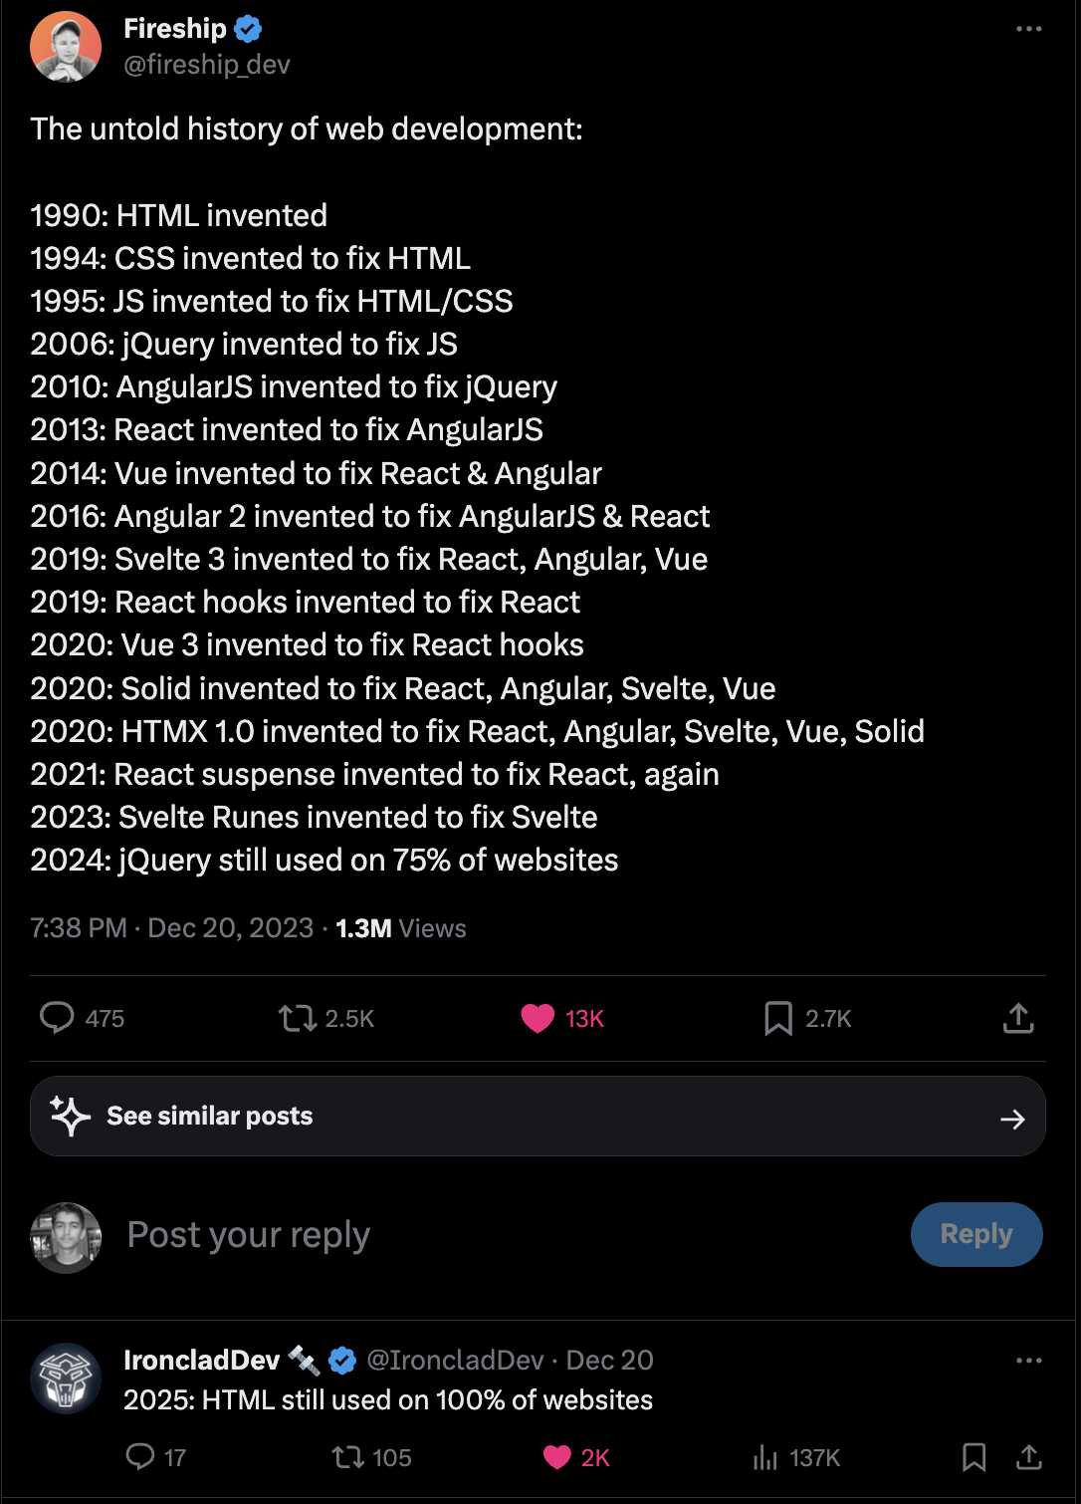
Inspiration for this talk:
I think JQuery was something that changed the whole JS ecosystem. It encouraged for ES6. Before it, JavaScript was not that powerful.
Then I thought will HTMX be doing the same things as jQuery did with web-dev?
The Answer lines in the hypertext. Which we use to link pages to the fundamentals of websites. Will this hyper-media be powerful enough to make a modern web-app?

Slide 4
About htmx :
htmx is a library that allows you to access modern browser features directly from HTML, rather than using javascript.
htmx gives you access to AJAX, CSS Transitions, WebSockets and Server Sent Events directly in HTML, using attributes, so you can build modern user interfaces with the simplicity and power of hypertext
htmx is small (~14k min.gz’d), dependency-free, extendable, IE11 compatible & has reduced code base sizes by 67% when compared with react
It stands for HTML eXtension.
First version was released on 2020 by Carson Gross.
Originally it was named intercooler.
You can check htmx.org and github/htmx for more info.
If you are don’t want official docs then hyperdome

Slide 5
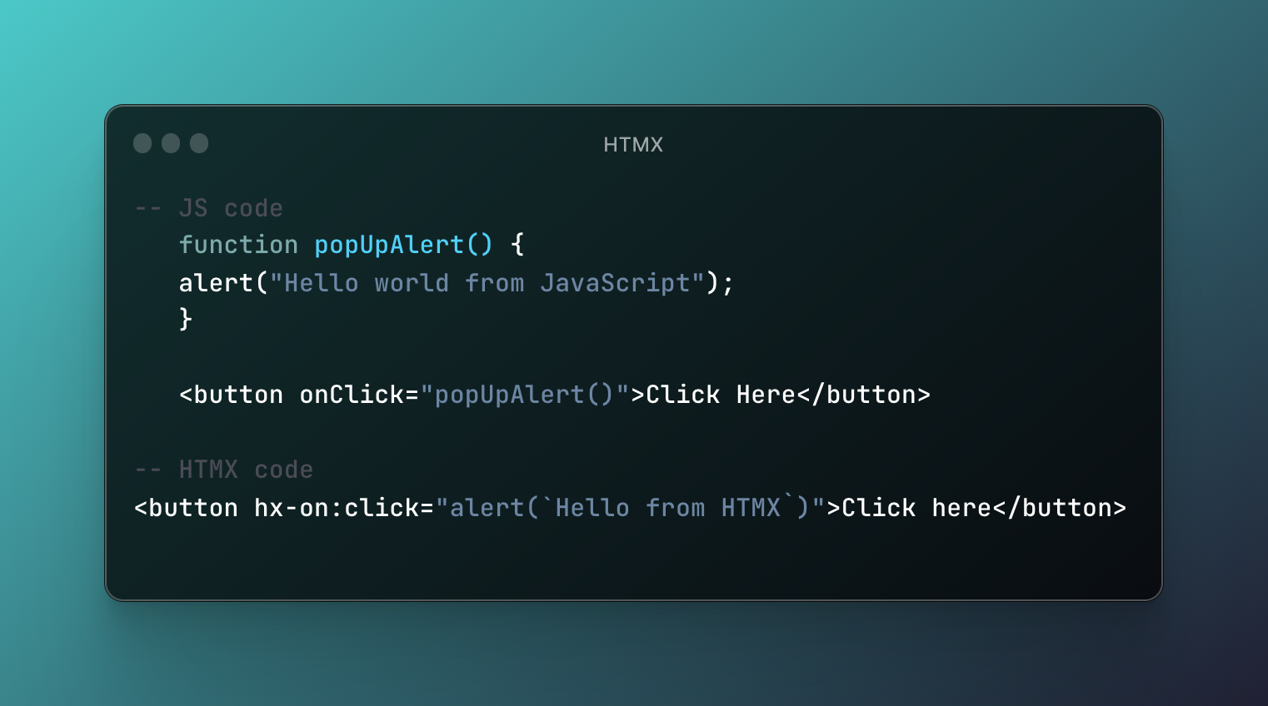
First look of htmx
Install using CDN, Download the min.js package or use npm install.
Use directly into existing HTML code.
HTMX is implemented on 2 levels. Client side and Server side.
Let's see first see the htmx on the client side.

Slide 6
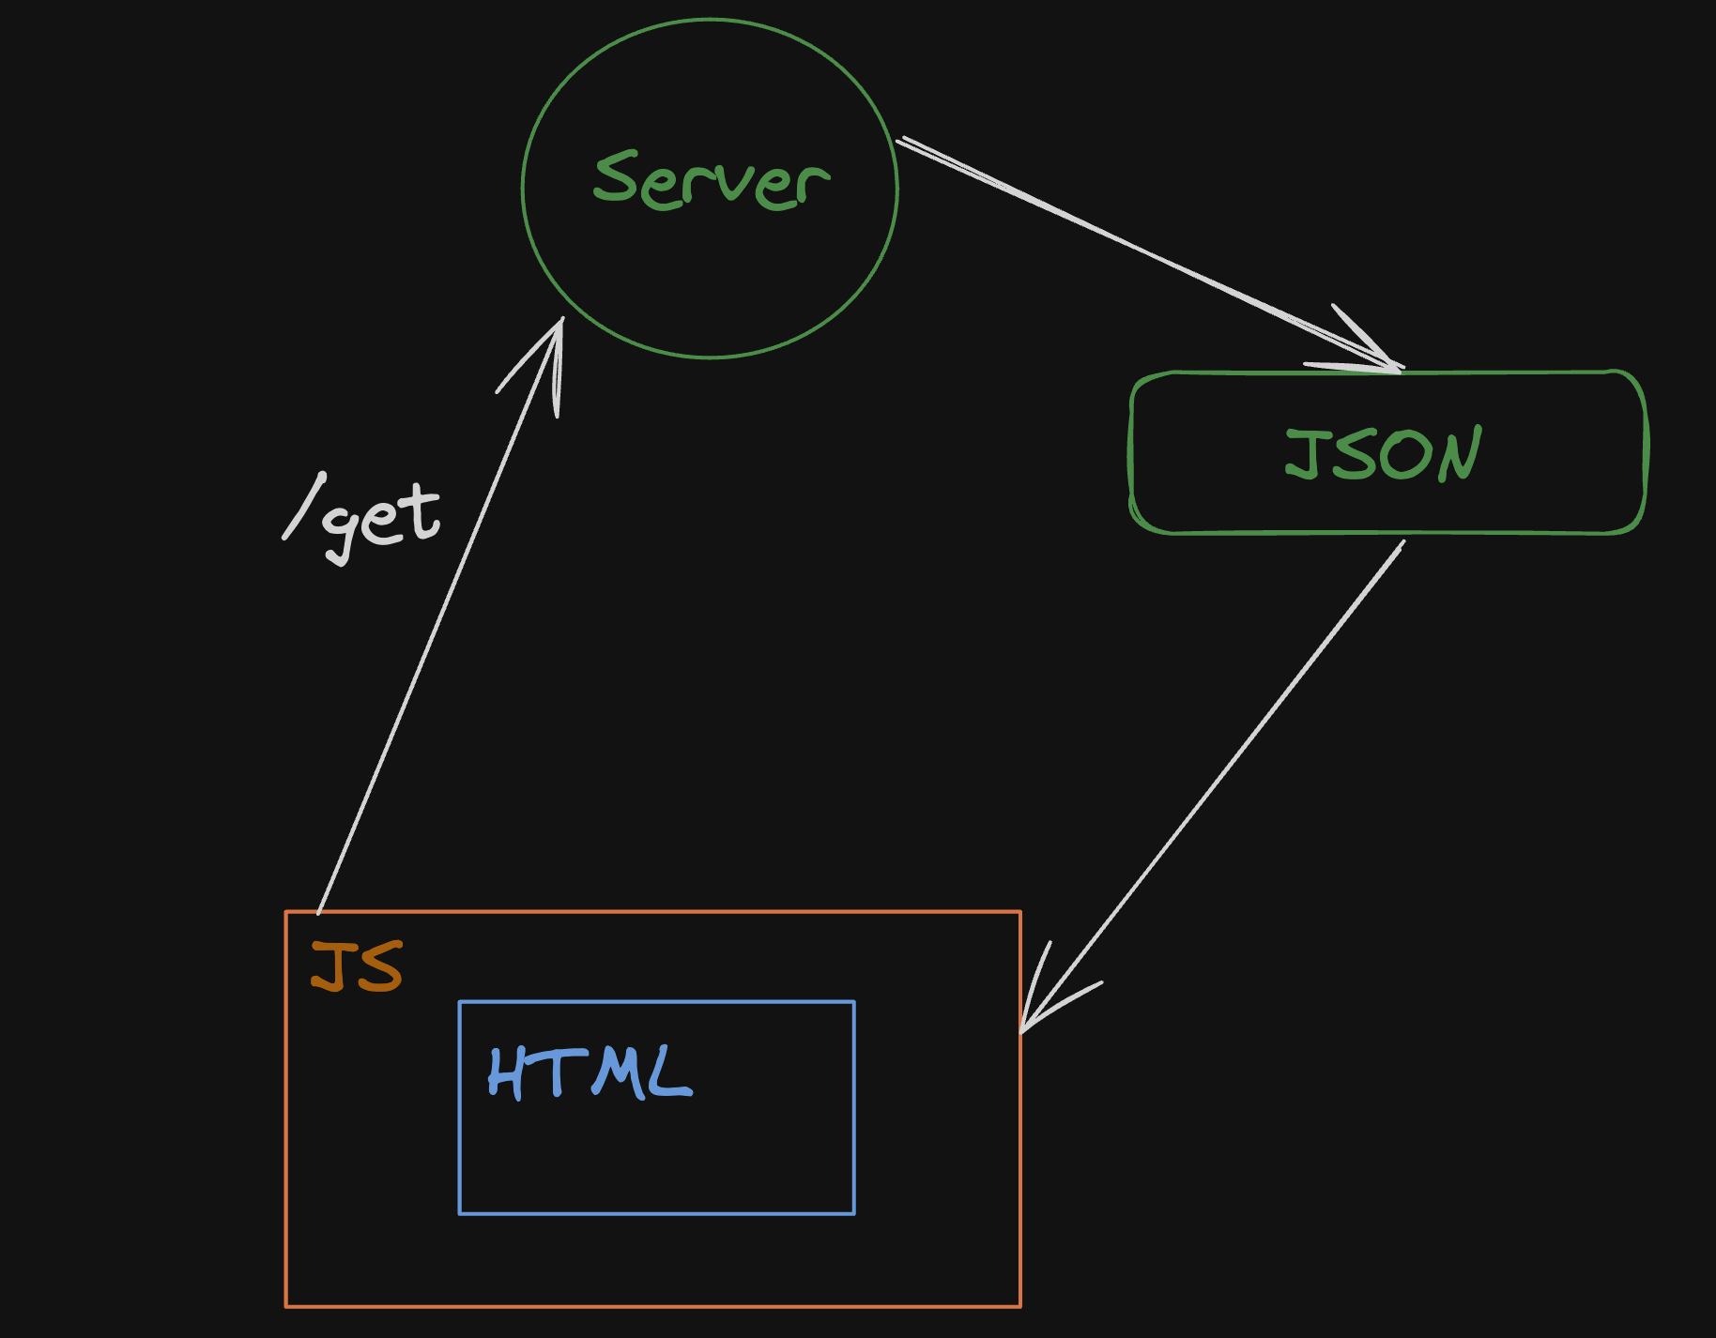
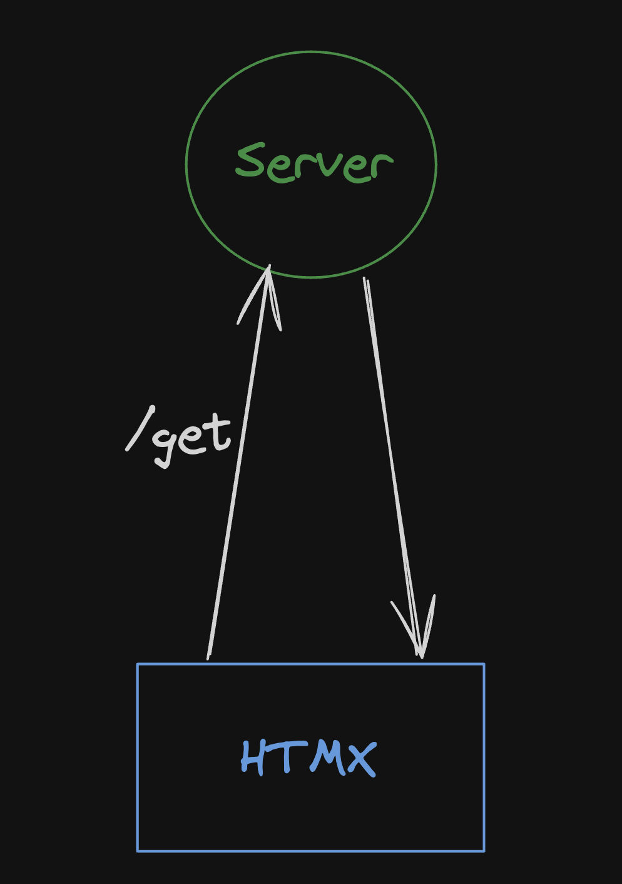
Real power of htmx
HTMX is based on HATEOAS(Hyper-media as the engine of the application State.
It extends the use case of hypertext. You can change any element of the webpage without reloading the whole page something like a SPA(Single Page Application) React.js.
Currently, HTML can not deal with the request-response cycle without JavaScript and JSON. But with HTMX we can get a response from the server without the need for JavaScript.

Slide 7
Benifits of htmx
HTMX offers several benefits over traditional AJAX frameworks:
Simplicity: HTMX is a very simple framework to learn and use. It has a small API and a straightforward syntax.
Performance: HTMX is very performant. It uses a lightweight event-driven architecture that minimizes the number of DOM manipulations.
Extensibility: HTMX is very extensible. It can be easily integrated with other libraries and frameworks.
Cross-platform: HTMX works on all major browsers and platforms.
Here are some specific examples of how HTMX can be used to improve the user experience:
Lazy loading: HTMX can be used to lazy load content on a page. This can improve the performance of your page by reducing the amount of data that is loaded initially.
Infinite scrolling: HTMX can be used to implement infinite scrolling. This allows users to scroll through a list of items without having to click on a "next" button.
Real-time updates: HTMX can be used to implement real-time updates. This allows users to see changes to a page as they happen, without having to refresh the page.
HTMX is a powerful tool that can be used to improve the user experience of your web applications. It is simple to learn and use, performant, extensible, and cross-platform.

Slide 8
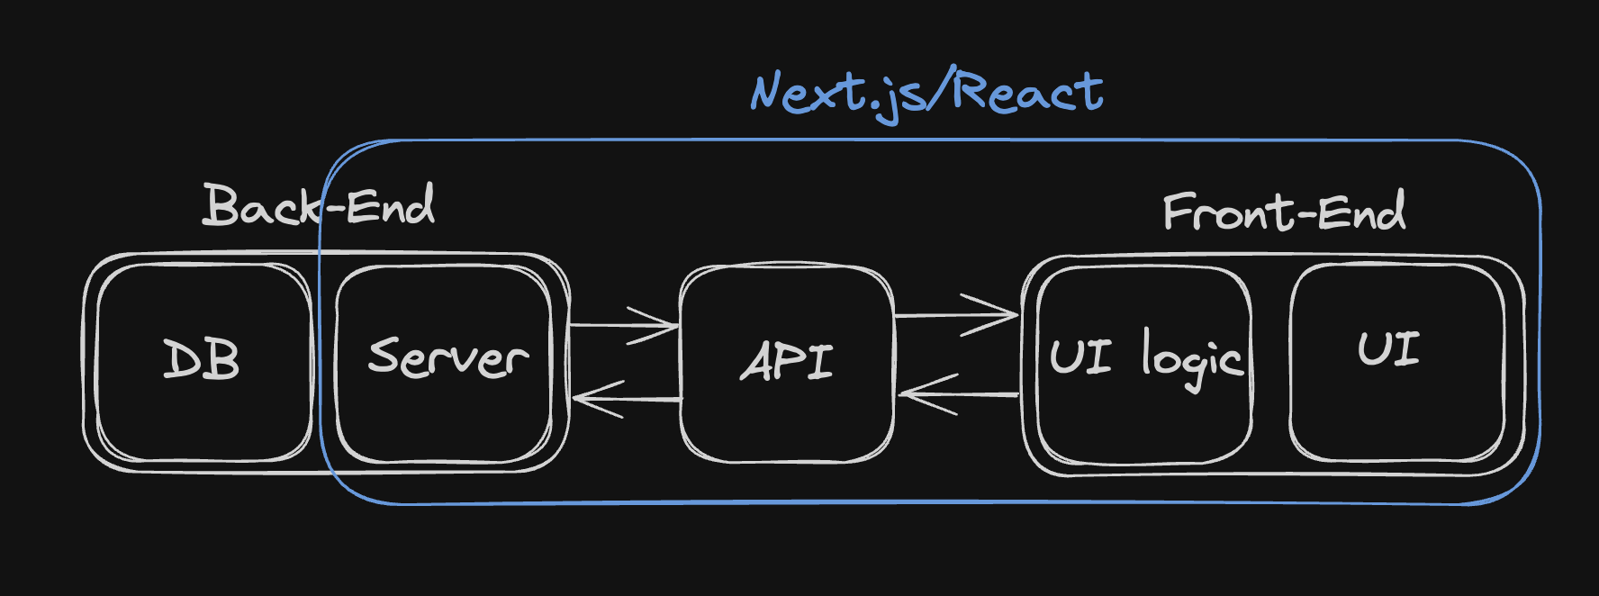
htmx is opposite of React.js
HTMX real power is unlocked with the request response from the server.
All the UI logic part of a website is also stored in the Server.
HTMX is a great option for a backend developer who doesn’t want to learn complex UI library like React.js
But React.js can do much more than htmx. It can save states, and break UI in components.
So, In short, htmx is great if you don’t have any complex UI part. Like banking also it saves the data from getting manipulated by the user.

Slide 9
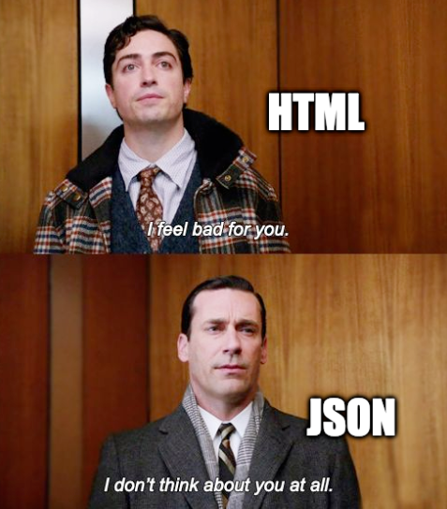
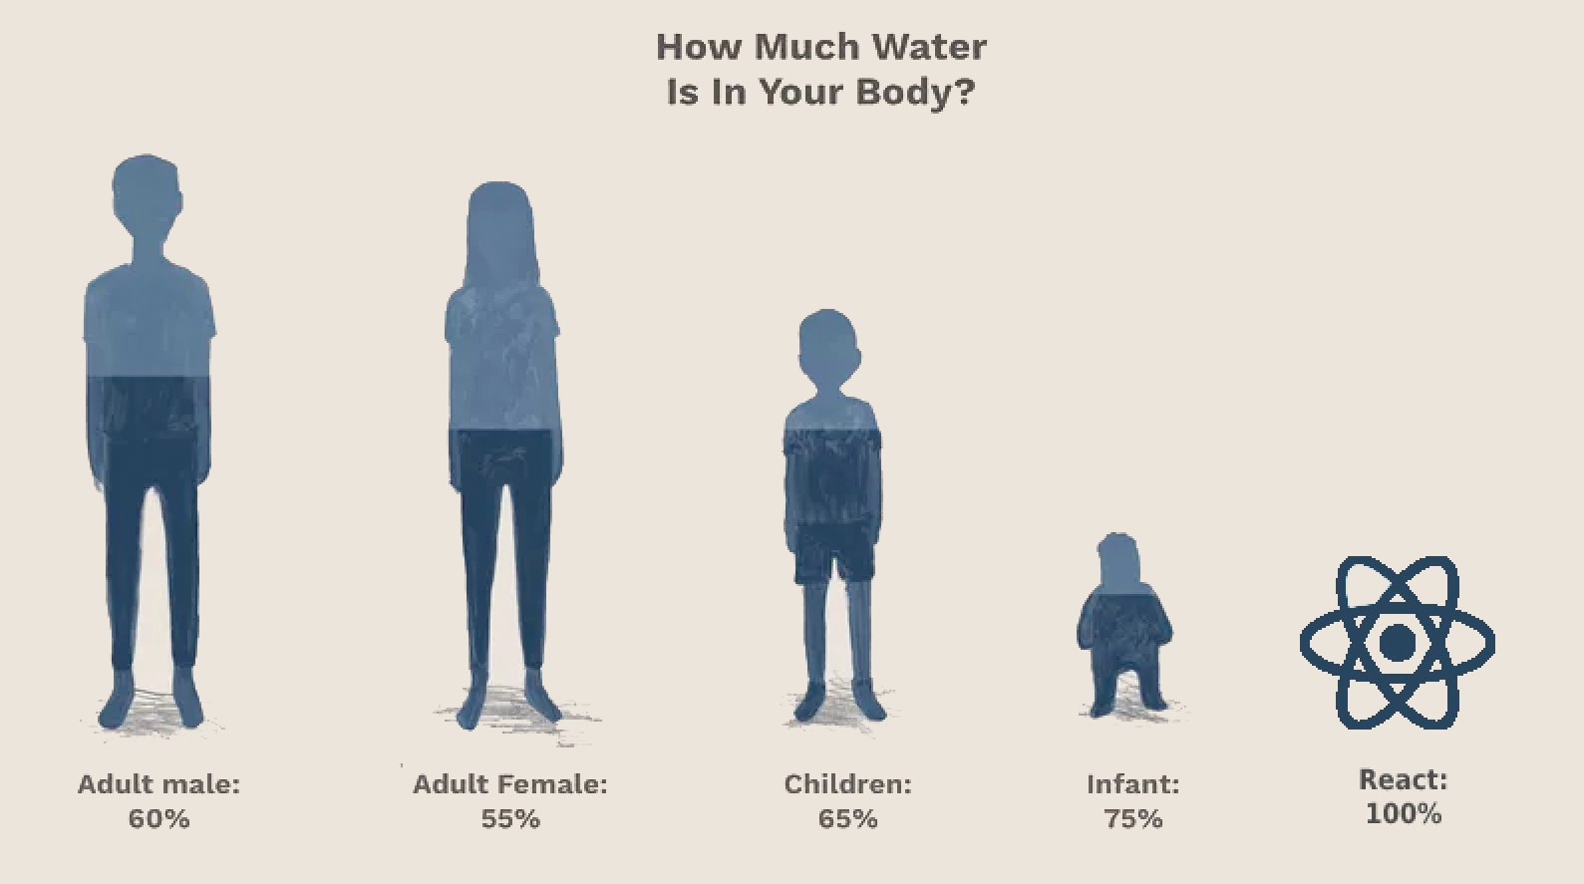
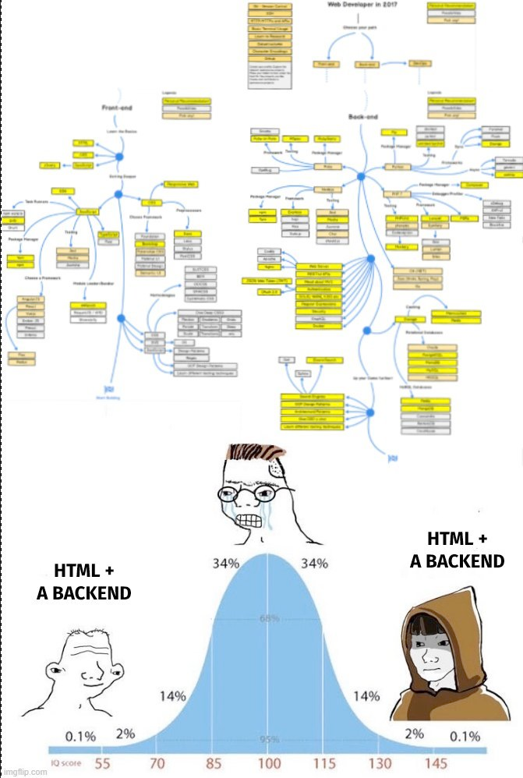
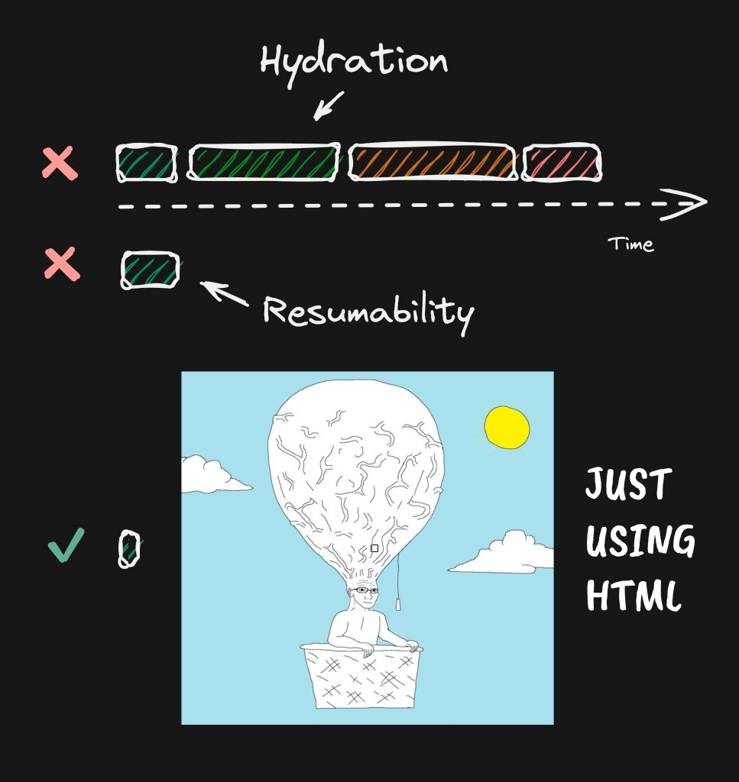
MEME

Slide 10
Thank you
And Happy New Year to all.

